Slide 1
English Stylistics
Week 10
Syntactic features (I)

Slide 2
In today’s class
A review of the poem-writing task
Syntactic features – Types of sentences

Slide 3
Review
What do you feel about writing poems?
Will you like to write some more in the future?

Slide 4

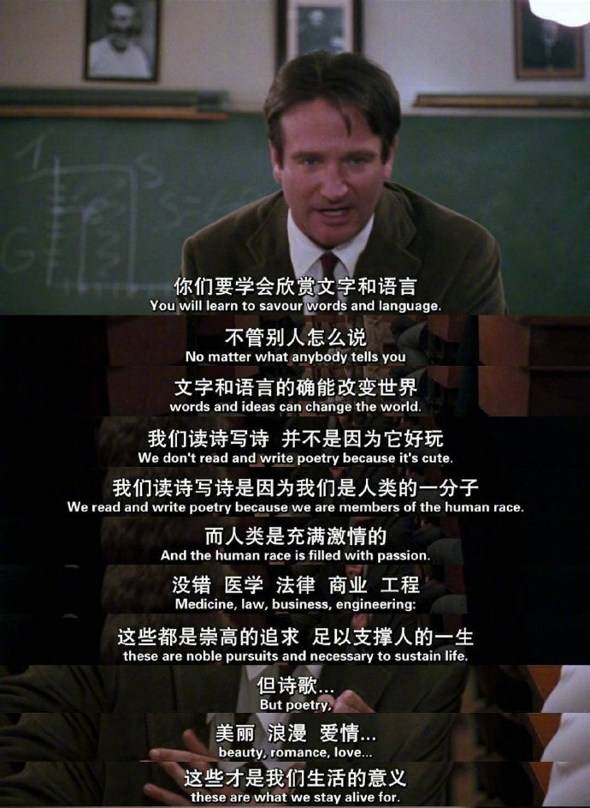

Slide 5
Shiny lines to share
I cursed my life being stuck in endless woe,
That made my love so high and me so low.

Slide 6
Shiny lines to share
Do not enquire the depth about the sea,
Sincere, sincere, my heart belongs to thee.

Slide 7



Shiny lines to share
What’s love about? A hundred times I’ve thought,
Like rose and marigold, forget-me-not.

Slide 8
Shiny lines to share
“Snow on the River”
Among the hills, the birds all disappear
Across the trails no one is there or near.
A fisherman alone in hat afloat
Is solely fishing snow in lonely boat.

Slide 9
Shiny lines to share
You stand on bridge, enjoy the pretty scene,
In eyes of men upstairs you are the queen.
The moon climbs to your window, shines like cream,
While you are also brightening one’s dream.

Slide 10
Shiny lines to share
To Ekaterina II
Remember come to see me in a crown
My glamor shines like diamonds on and on.
When I do count my cards and watch them fall.
My rivals see their blood on marble wall.

Slide 11
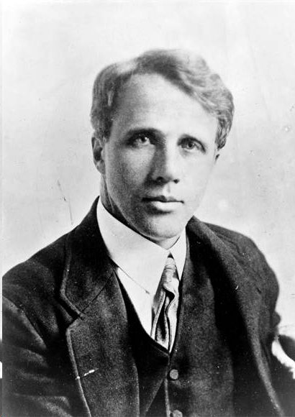
The parody of Robert Frost
Frost’s wife/ Frost’s mom/ Frost’s girlfriend
Frost’s horse/ mouse/ shoe/ fish/ bird…
Frost’s neighbor (who owns the woods)
Frost’s unexpected visitor
Frost’s students …

Slide 12
The parody of Robert Frosts
12-minute running test
Waiting for the transport early in the morning
Burning the mid-night oil against deadlines
Waiting for a girlfriend/boyfriend impatiently
Getting lost in a miserable late evening
Trying to steal/ to peep/ to kill

Slide 14
Syntax
The patterns, principles and rules of sentences in a given language.
Morpho-syntax: Morphology and syntax forms the core of grammar

Slide 15

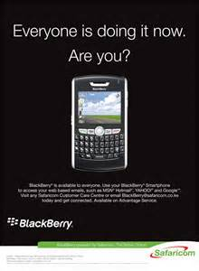
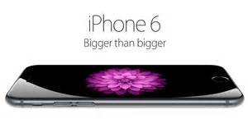

Slide 16
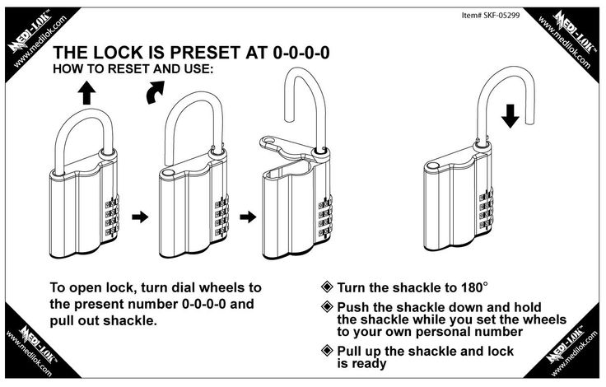

Slide 17
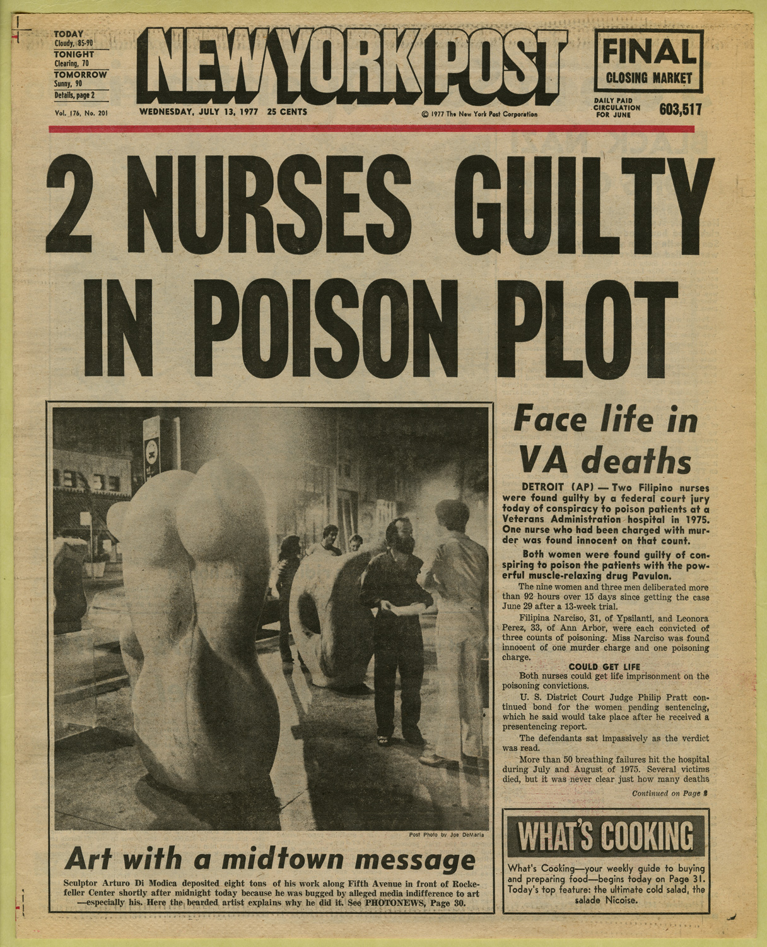

Slide 18
Sentence types
Sentence types by structure
Sentence types by voice
Sentence types by function
Sentence types by length

Slide 19
Sentence types – structure
Simple sentences
Complex sentences
Compound sentences
Compound complex sentences

Slide 20
Compound complex sentences
"For in the end, freedom is a personal and lonely battle; and one faces down fears of today so that those of tomorrow might be engaged.“ (Alice Walker, In Search of Our Mothers' Gardens, 1983)

Slide 21
Active vs. passive voices
"America was discovered accidentally by a great seaman who was looking for something else . . .. America was named after a man who discovered no part of the New World. History is like that, very chancy.“ (Samuel Eliot Morison, The Oxford History of the American People, 1965)

Slide 22
Be evasive with passive voice
"We did not achieve what we wished, and serious mistakes were made in trying to do so.“ (Ronald Reagan, January 1987)
"Mistakes were made here by people who either did it deliberately or inadvertently.“ (Bill Clinton, January 1997)

Slide 23
Academic writing
The researcher designed a questionnaire of 25 questions and distributed the copies randomly to the students in the library.→
The questionnaire, consisting of 25 questions, was designed for the present research and randomly distributed to the students in the library.

Slide 24
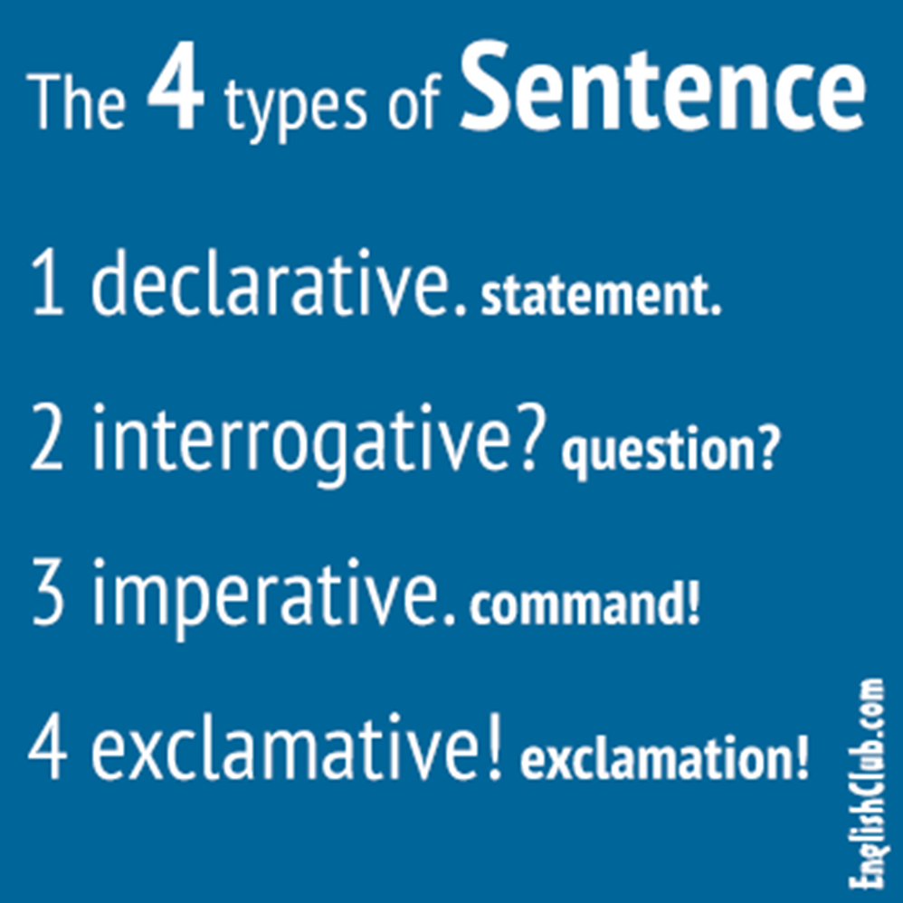
Sentence types – functions

Slide 25
Sentence length
Length by words, syllables or characters
15-20 words or 22-33 syllables (Oxford Guide to Plain English)
“All short will sound stupid. All long will sound stuffy.”
Variety of sentences

Slide 26
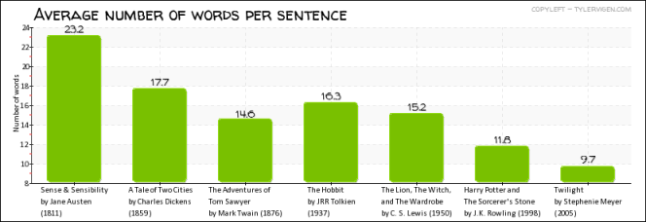
Sentence lengths and readability

Slide 27
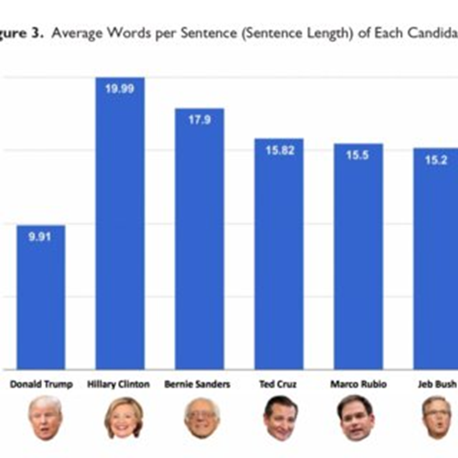
Sentence lengths and intelligibility

Slide 28
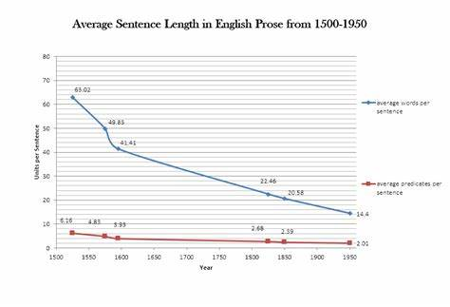

Slide 29
Short sentences
Direct, concise, terse, clear
Swift, compact, continuous
Abrupt, unexpected

Slide 30
Long Sentences
Solemn, formal, detailed
Complex, sophisticated
Messy, confused, suffocated
Reading: Text 24

Slide 31
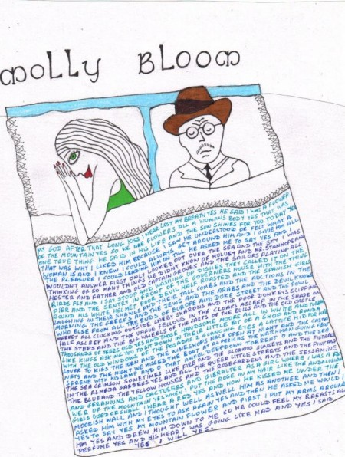
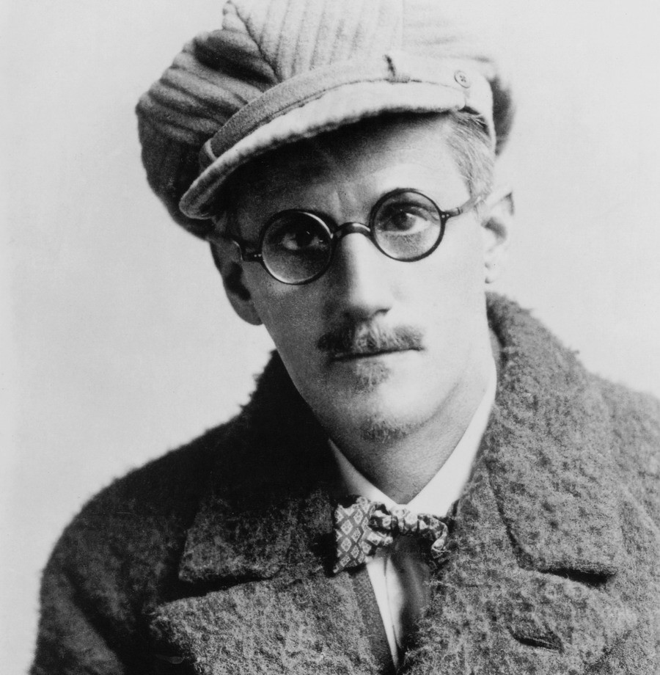
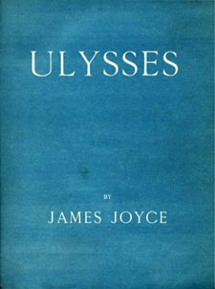
James Joyce (1882-1941)

Slide 32
Stream of consciousness
A literary technique characterized by a flow of thoughts and images, which may NOT always appear to have a coherent structure or cohesion.
Fragmentary, incoherent, messy and lengthy
Not rational (or logical)

Slide 33
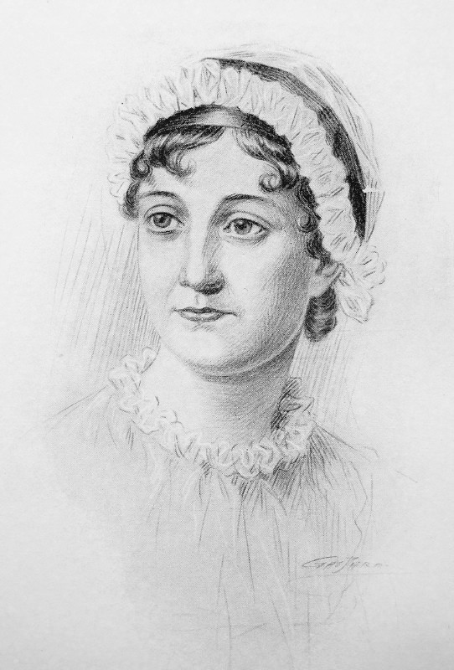
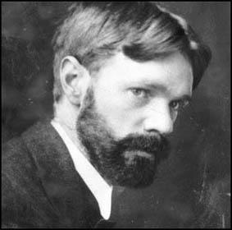
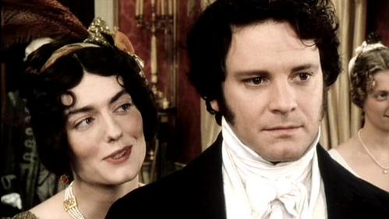
Text 25-26
D. H. Lawrence (1885-1930)
J. Austin (1775-1817)

Slide 34
Summary: Sentence types
→ structure
→ voice
→ function
→ length
The Key: Variety

